Slide 1

Statistical Definition of Entropy

Slide 2
Entropy:
Entropy is a measure of molecular disorder.
Greater is disorder of molecular motion greater is the entropy.
The connection between statistical mechanics is provided by entropy.
Natural processes tend to move toward a state of greater disorder.

Slide 3
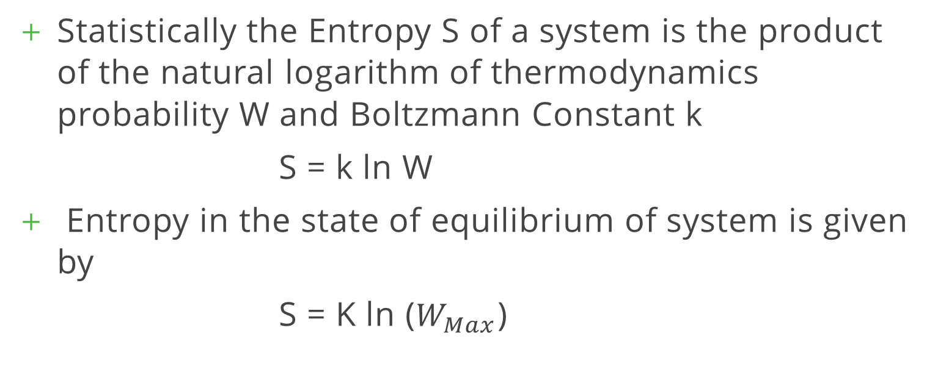
Statistical Definition of Entropy:
Statistically the Entropy S of a system is the product of the natural logarithm of thermodynamics probability W and Boltzmann Constant k
S = k ln W
Entropy in the state of equilibrium of system is given by
S = K ln ($W_{Max}$)

Slide 4
Change of Entropy of a system:
The thermodynamic probability W is a function of no. of particles (n) (which is function of µ amount of substance, the total no. of available phase space cells (which in turn depends upon the volume) and the energy u of the system.
S = f (u, v, µ)
Therefore entropy s, is also a function of µ, v, u.
So the entropy of the system can be changed by changing the energy µ.

Slide 5
Additive Nature of Entropy:
S1 and S2 be entropies of the sub-systems A and B respectively.
S = S1 + S2
In general, the entropy of the system is given by the summation of entropies of all the subsystems of the system.
i.e. S = ∑ Si

Slide 6
Third Law of Thermodynamics:
Thermodynamics probability W decreases with the decrease of temp.
The minimum possible temperature is called the absolute zero.
S = k log W
When W = 1, S=0
The absolute zero temperature is 0 kelvin

Slide 7
Principle of increase of entropy:
A natural process always takes place in such a direction as to cause an increase in the entropy of the system and surroundings.
In an isolated system the entropy of the system always tends to increase.
It is the law of the nature that disorder is more probable than order.

